Slide 1
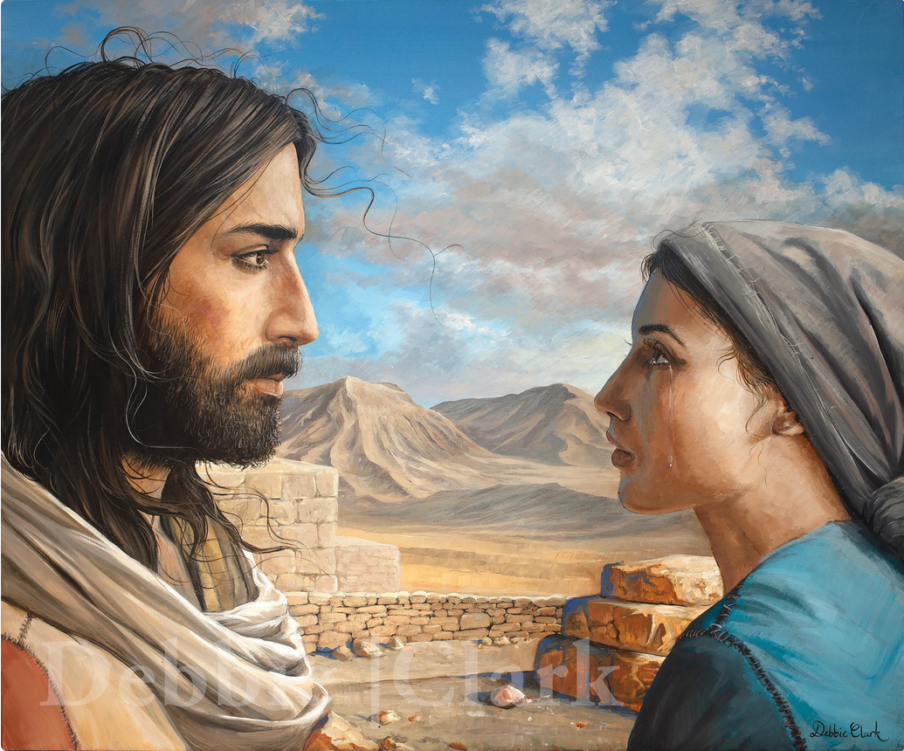
Martha’s story
Who’s That? #2
Jesus— “I am the resurrection and the life.”

Slide 2
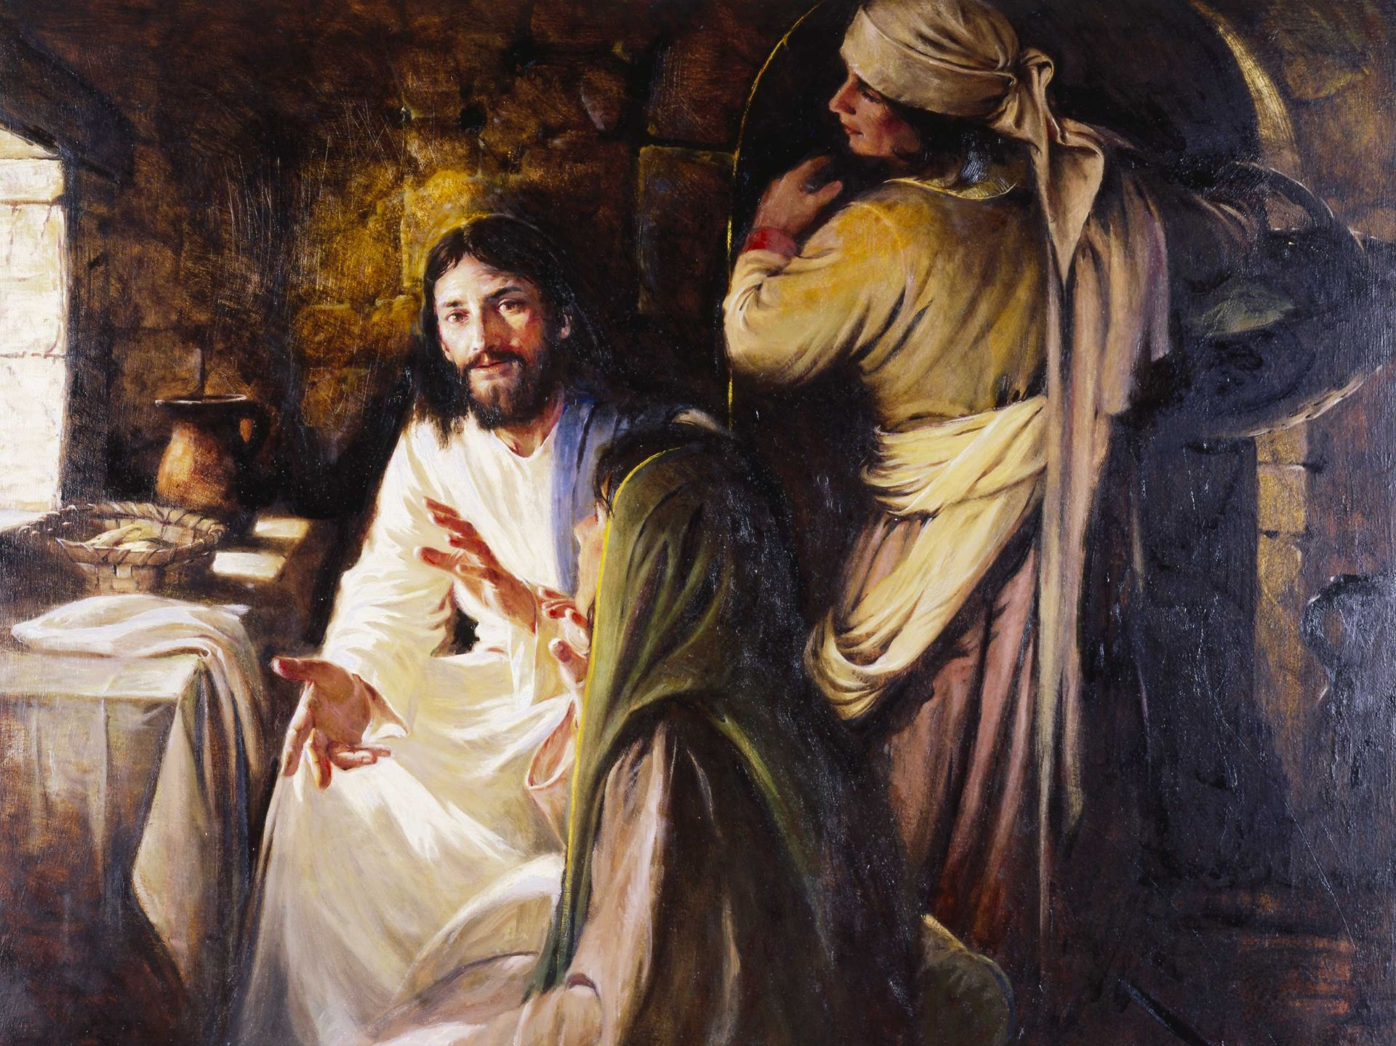
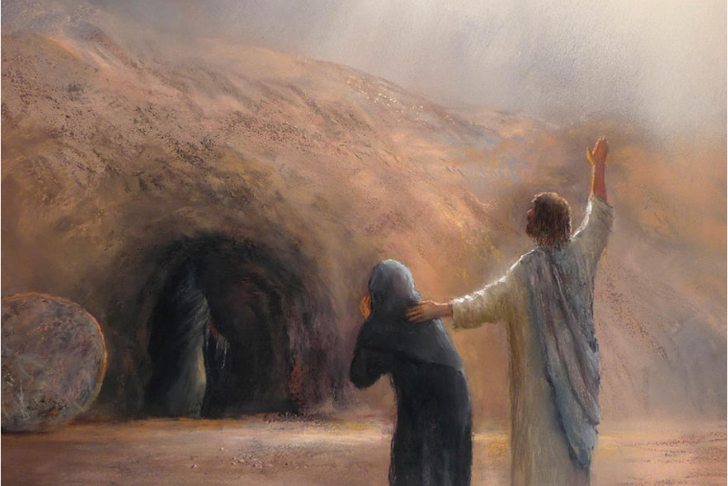
Tour of the Gospels
 | Martha | Mary sister | Lazarus brother
Matthew |  | ✓
Mark |  | ✓
Luke | ✓ | ✓
John | ✓ ✓ | ✓ ✓ | ✓ ✓
✓named ✓unnamed
centre: Debbie Clark Art

Slide 3
Tour of the Gospels
 | Martha | Mary sister | Lazarus brother | Bethany near Jerusalem
Matt. |  | ✓ |  | ✓
Mark |  | ✓ |  | ✓
Luke | ✓ | ✓ |  | ✓ ✓
John | ✓ ✓ | ✓ ✓ | ✓ ✓ | ✓ ✓
✓named ✓unnamed
centre: Debbie Clark Art

Slide 4
Tour: Galilee to Jerusalem
Judea Samaria Galilee
Source: Biblical Archaeology Society

Slide 5
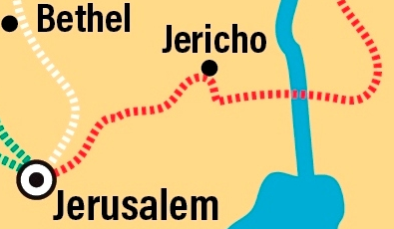
Tour: Bethany on the Jerusalem-Jericho road
Bethany
Source: Biblical Archaeology Society

Slide 6
Luke 10:38-42
³⁸ As Jesus and his disciples were on their way, he came to a village where a woman named Martha opened her home to him. ³⁹ She had a sister called Mary, who sat at the Lord’s feet listening to what he said.
⁴⁰ But Martha was distracted by all the preparations that had to be made. She came to him and asked, “Lord, don’t you care that my sister has left me to do the work by myself? Tell her to help me!”
⁴¹ “Martha, Martha,” the Lord answered, “you are worried and upset about many things, ⁴² *but few things are needed—or indeed only one. Mary has chosen what is better, and it will not be taken away from her.” NIV
*or: “but only one thing is needed”

Slide 7
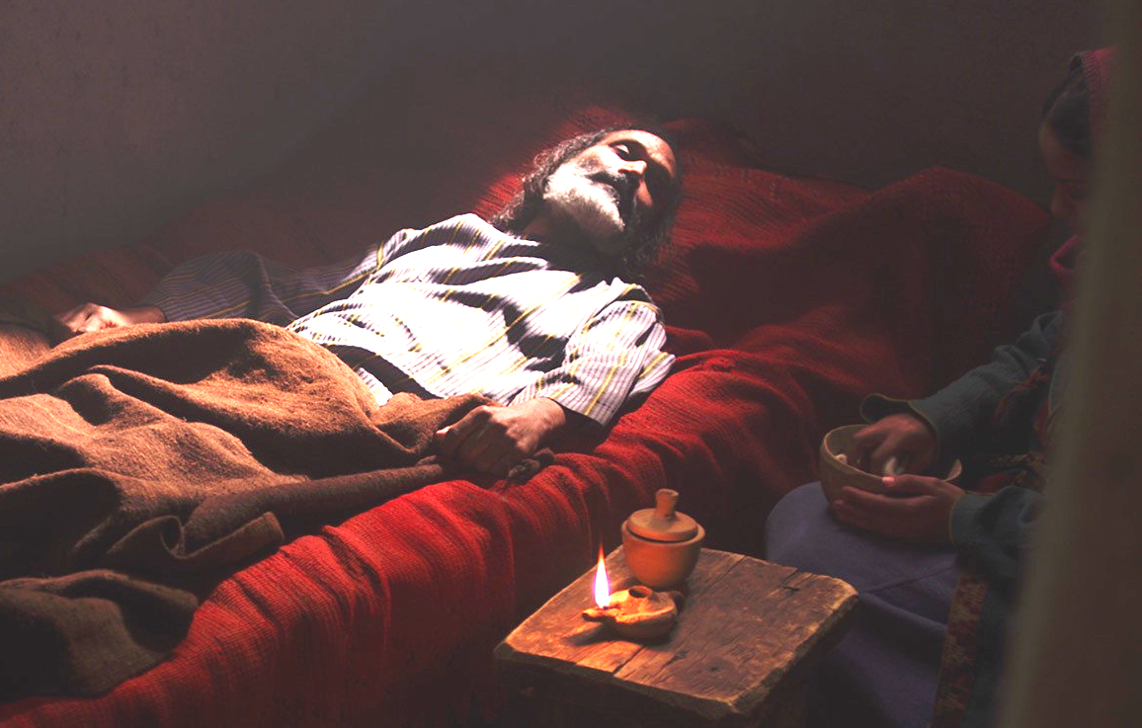
John 11: 1-16
¹ Now a man named Lazarus was sick. He was from Bethany, the village of Mary and her sister Martha. ² (This Mary, whose brother Lazarus now lay sick, was the same one who poured perfume on the Lord and wiped his feet with her hair.) ³ So the sisters sent word to Jesus, “Lord, the one you love is sick.”
⁴ When he heard this, Jesus said, “This sickness will not end in death. No, it is for God’s glory so that God’s Son may be glorified through it.”
⁵ Now Jesus loved Martha and her sister and Lazarus. ⁶ So when he heard that Lazarus was sick, he stayed where he was two more days, ⁷ and then he said to his disciples, “Let us go back to Judea.” …

Slide 8
John 11: 17-27
¹⁷ On his arrival, Jesus found that Lazarus had already been in the tomb for four days. …¹⁹ Many Jews had come to Martha and Mary to comfort them in the loss of their brother. ²⁰ When Martha heard that Jesus was coming, she went out to meet him, but Mary stayed at home.
²¹ “Lord,” Martha said to Jesus, “if you had been here, my brother would not have died. ²² But I know that even now God will give you whatever you ask.”
²³ Jesus said to her, “Your brother will rise again.”
²⁴ Martha answered, “I know he will rise again in the resurrection at the last day.”
²⁵ Jesus said to her, “I am the resurrection and the life. The one who believes in me will live, even though they die; ²⁶ and whoever lives by believing in me will never die. Do you believe this?”
²⁷ “Yes, Lord,” she replied, “I believe that you are the Messiah, the Son of God, who is to come into the world.”

Slide 9
John 11: 28-44
²⁸ After Martha had said this, she went back and called her sister Mary aside. “The Teacher is here,” she said, “and is asking for you.” …
³⁸ Jesus, once more deeply moved, came to the tomb. It was a cave with a stone laid across the entrance. ³⁹ “Take away the stone,” he said.
“But, Lord,” said Martha, the sister of the dead man, “by this time there is a bad odour, for he has been there four days.”
…⁴³ Jesus called in a loud voice, “Lazarus, come out!”…

Slide 10
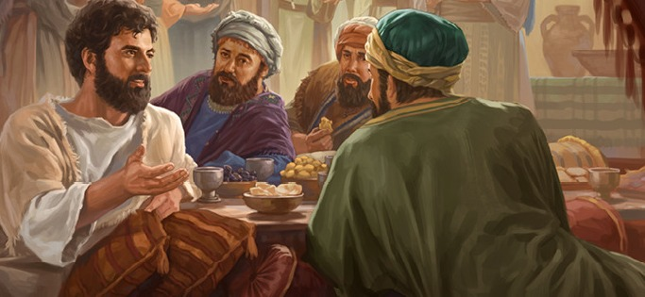
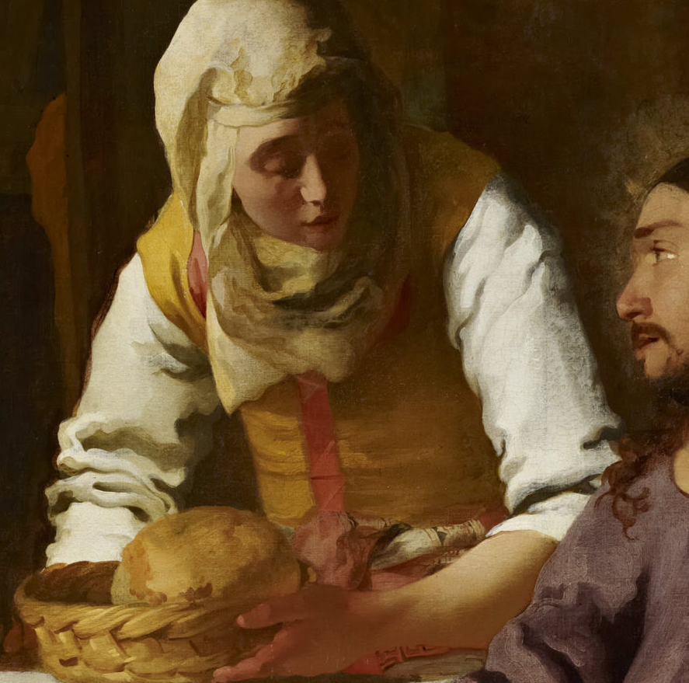
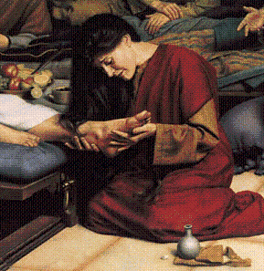
John 12: 1-11
¹ Six days before the Passover, Jesus came to Bethany, where Lazarus lived, whom Jesus had raised from the dead. ² Here a dinner was given in Jesus’ honour. Martha served, while Lazarus was among those reclining at the table with him. ³ Then Mary took about a half a litre of pure nard, an expensive perfume; she poured it on Jesus’ feet and wiped his feet with her hair. And the house was filled with the fragrance of the perfume. …

Slide 11
Martha’s story
Martha …
… to whom Jesus said
“I am the resurrection and the life.”
And Martha replied, “Yes, Lord, I believe.”
Debbie Clark Art

